Slide 1
Canadian Illicit Cannabis Market
November 2019
Jacob Miller (jacob.miller@canada.ca)
Office of Drug Research and Surveillance
Controlled Substances and Cannabis Branch
Health Canada

Slide 2
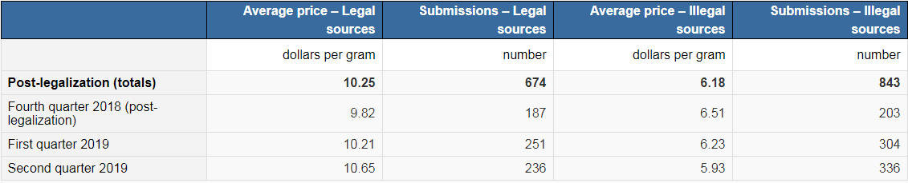
Illicit Cannabis Potential Sources
CCS:
From a friend (34%)
From a compassion club/dispensary (15%)
Shared among friends (13%)
From a dealer (7%)
Grown by or for them (7%)
From an acquaintance (7%)
Statscan crowdsourcing:
Dark web:
“We looked into patterns of sales at two points in 2018, prior to cannabis legalization (July 2018), and after (November 2018)… The volume of cannabis shipped appears to have also increased over the same period, rising from hundreds of kilograms to perhaps as much as 2,229 kilograms per year for the most optimistic model” (Décary-Hétu, 2019)
Open web:
No source?

Slide 3
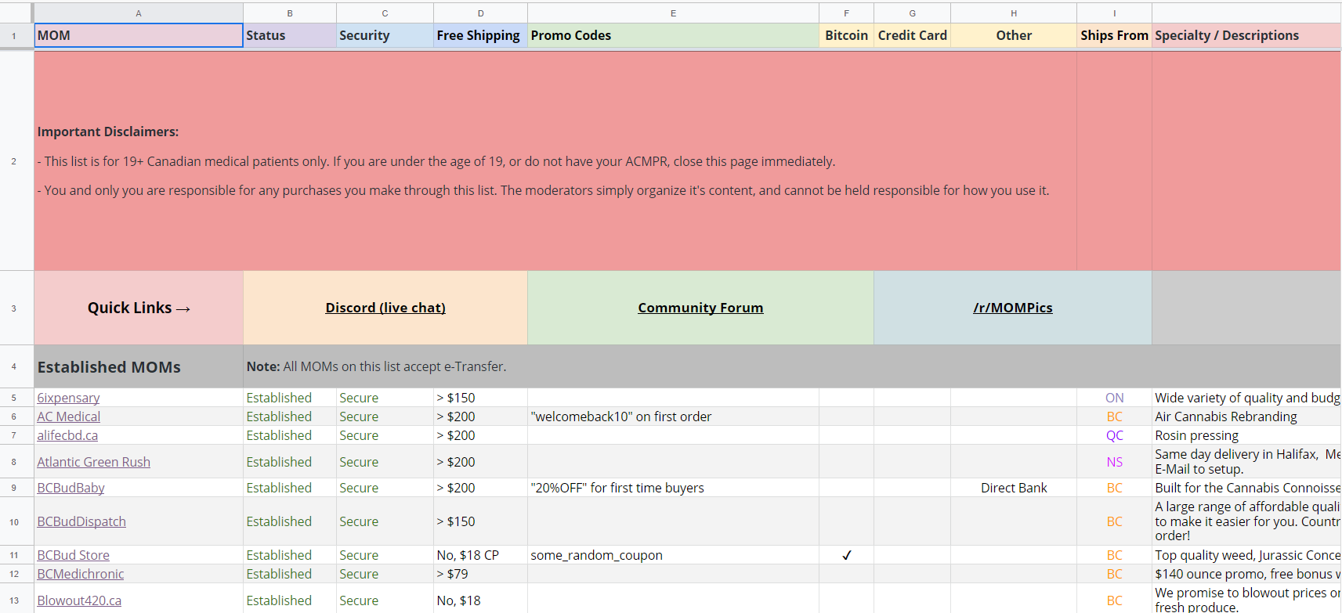
Canadian Mail Order Marijuana websites
300+ Canadian websites selling marijuana online

Slide 4
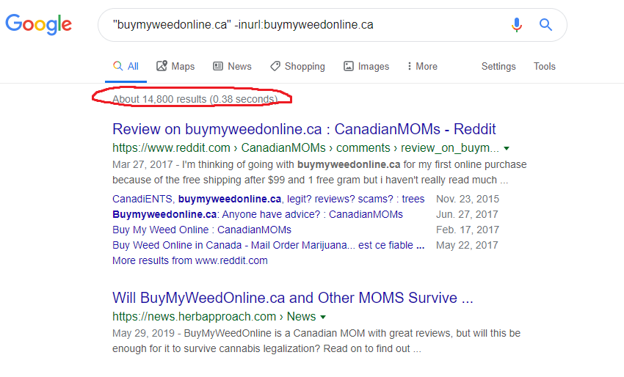
Finding the most popular sites

Slide 5
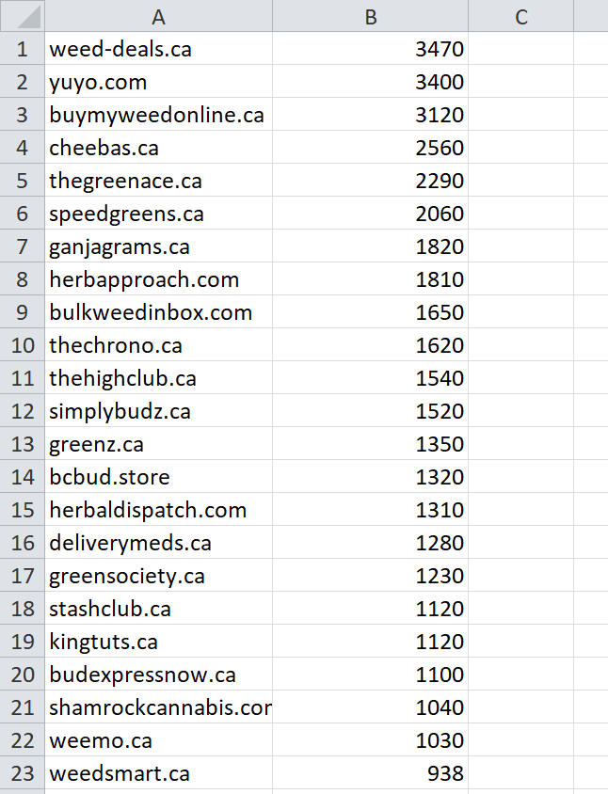
Finding the most popular sites

Slide 6
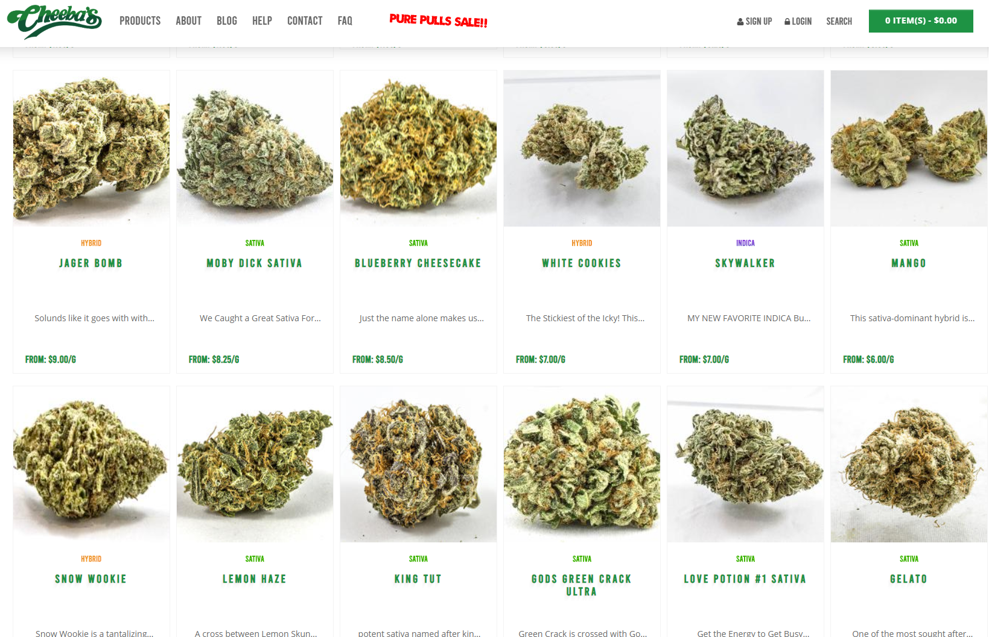
Scraping

Slide 7
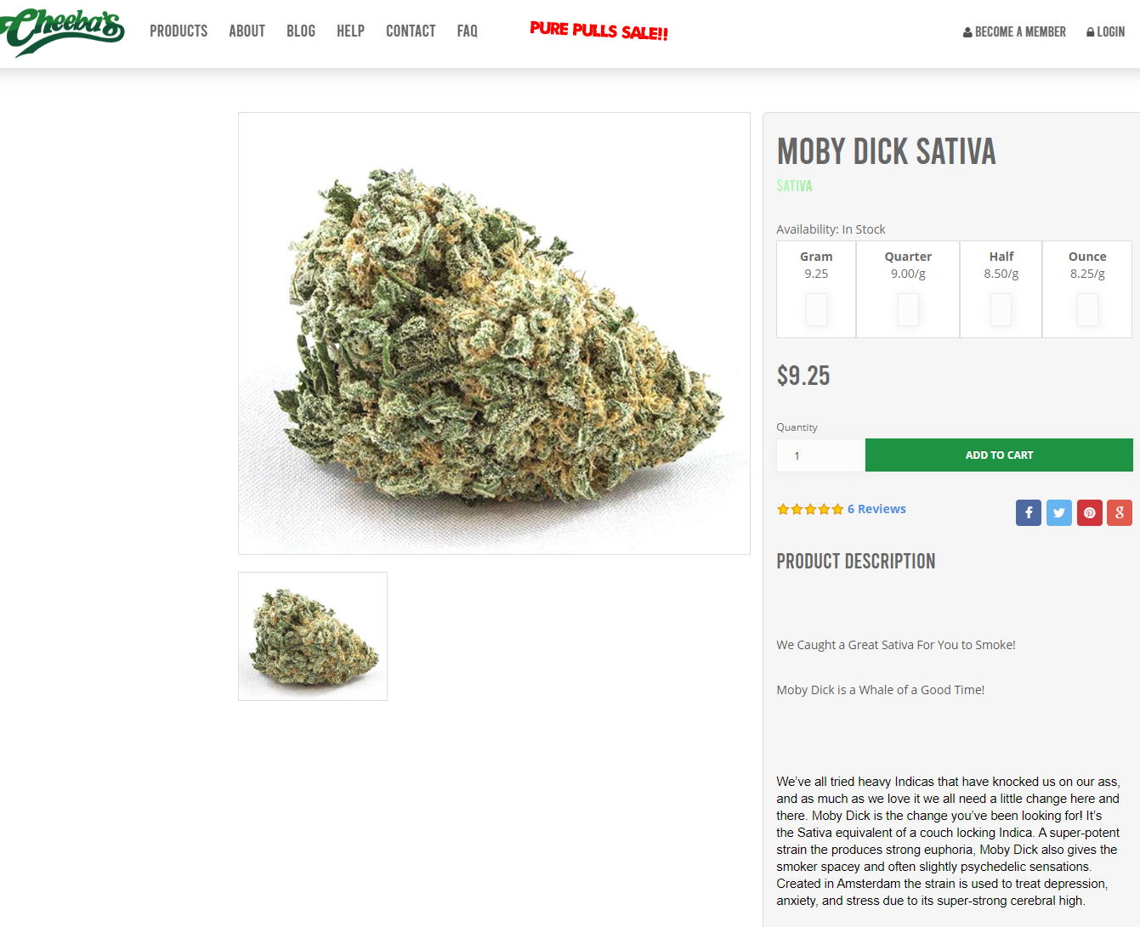
Scraping

Slide 8
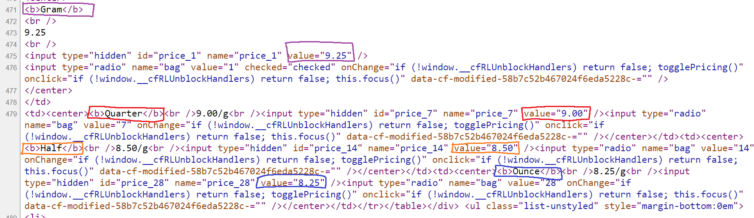
Data extraction

